Slide 1
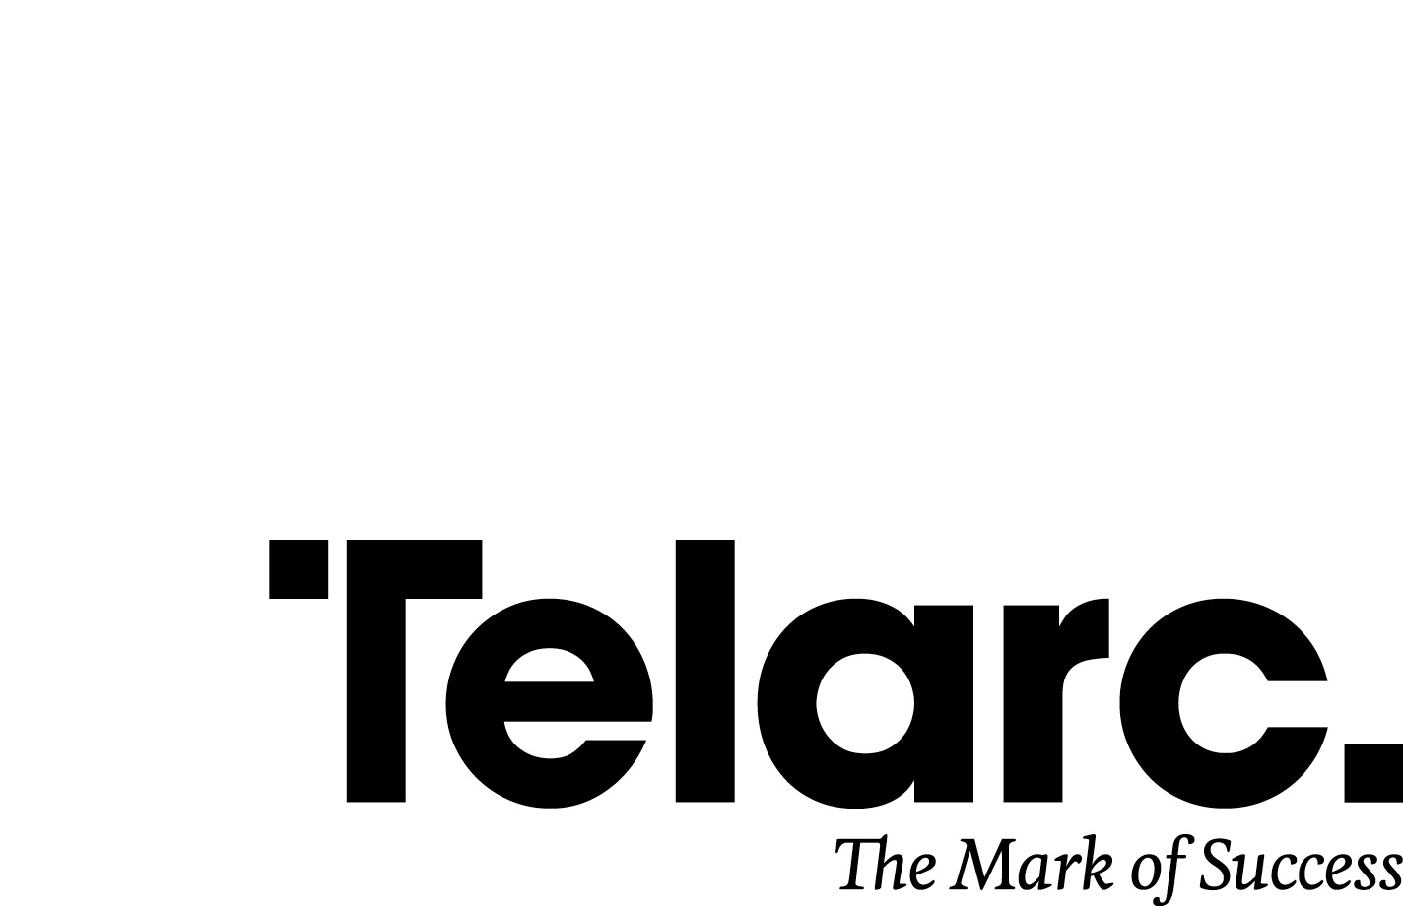
Certification – what it is and how it might impact the H&S landscape in New Zealand -
Presenter: Philip Cryer
October 2019

Slide 2
My topic today is Certification support Services… so without further ado lets rip into this riveting topic
Let’s start with some definitions of the concepts that will be discussed today
Management System
a management system is the framework of:
Policies
Processes
Procedures (Tasks)
used by an organization to ensure that it can fulfil all the tasks required to achieve its objectives
Standard
a standard is made up of details of requirements, specifications, guidelines and characteristics that products, services and processes should consistently meet in order to ensure:
that they match stakeholder expectations
that they are fit for purpose
that they meet the needs of their users (both internally and externally)

Slide 3
Standards can be seen as compliance…………… or, they can seen as valued added interventions used as a mechanism to drive improvement
How do they help you?
with a well-designed management system, your company can -
identify problems and help improve a wide range of outputs to better meet the needs of your customers, your workers, your shareholders and your stakeholders (including the public)
How does this help a regulator?
by referencing standards in legislation, regulators draw on -
existing best practice developed by expert committees using a consensus-based and
transparent process.
incorporating standards into law also allows regulators to -
provide detailed requirements without encumbering regulations or guidance with
technical detail.

Slide 4
and a company like Telarc, which has been around for 45 years, and is Government owned, continues to deliver in this space
What do people like Telarc do?
we come into your business –
to provide you with an impartial and relevant intervention against a recognised and relevant standard
to give you confidence that workers are conducting activities that reflect the organisation’s agreed policies, processes and procedures
to provide a report and a series of improvement activities that need to be worked on within the guidelines of the standard to allow and retain certification
I hope you now have a better feel as to what a standard is, and why and when they are useful and how they can be monitored

Slide 5
Let’s look back, to look forward……… workers well-being has made significant progress in the last 150 years
1865
1894
1926
1944
1946
1992
2003
2015
Slavery
Abolished
5 day work
week introduced
Minimum wage
introduced
Holidays
Act introduced
Annual Holidays
Act introduced
in N.Z. (2 weeks)
Health & Safety
in employment
Act
Industrial Conciliation
and Arbitration Act
introduced in N.Z.
Health & Safety
at Work Act
The pace at which Legislation, Regulations and Guidance is being
Developed in NZ (and globally) is gaining pace

Slide 6
In NZ we have seen management system standards developed that have stood the test of time……..and in some cases too much time
2001 - AS/NZS 4801
developed by the Australian and New Zealand standards associations
refers to the elimination of work-related injury
more defined process for reporting, health assessment, and evaluation of the HIRAC (Hazard
Identification, Risk Assessment and Control) process
The withdrawal timing is becoming clearer as Australia communicates its intention to withdraw

Slide 7
and in NZ we have seen management system standards developed that have stood the test of time……..and in some cases to much time
2002 - ACC WSMP Programme
conformance product developed by ACC
encouraged creation of safer working environments
developed to reduce the number and severity of workplace injuries.
has now been withdrawn from the NZ marketplace
2002 – ACC Partnership programme;
similar objectives to the ACC WSMP scheme
discount scheme developed by the ACC for organisations who pay a work levy +$250k p.a.
entitles employers to downward levy adjustments in exchange for taking responsibility for their employees’ work injury claims.
under the Programme, their existing levies can be adjusted by up to 90%
findings of the review process will be available in early 2020 for consultation.

Slide 8
and in NZ we have seen management system standards developed that have stood the test of time……..and in some cases to much time
2007 - OHSAS 18001
developed by a group of leading certification bodies from an existing British standard
18001 commits to the prevention of injury and ill health within the described scope of the management system
more clearly defines the roles of evaluation and compliance, incident investigation, nonconformity, and corrective and preventive action, and management review
JASANZ have advised this standard will be phased out within 3 years of ISO45001’s introduction

Slide 9
….with the change in philosophy around how to better manage worker well-being new standards have arrived to help NZ business
2018 – ISO45001
an international standard for occupational health and safety (OH&S) that was launched globally on the 12th March 2018
based on many years of research by a respected and knowledgeable international committee
backed by many other developed countries and international organisations
integrated with other management system standards. (ISO9001 and ISO14001 in partic.)
premised on assessments being conducted through strong engagement with workers

Slide 10
….with the change in philosophy around how to better manage worker well-being new standards have arrived to help NZ business
2019 – Q-Safe
Q-Safe is an unaccredited scheme developed by Telarc in 2005, and updated in 2019, as an alternative, annual H&S assessment for NZ SME’s
enables New Zealand businesses to better address the requirements of the Health and Safety at Work Act 2015 and align with international best practice.
provides a framework for small to medium low to medium risk businesses to establish, manage, monitor and improve their H&S system – using principles of Quality as a base.
contains elements of 45001 that allow for organisations to establish foundations that can be leveraged into the larger schemes as and when the business grows, or requires it.

Slide 11
which brings us to today....we find ourselves facing the leading edge of an H&S landscape that is in a state of upheaval
2010
2015
2016
2017
2017
2018
2018
2019
AS/NZS ISO45001
launched
Pike River
began
ACC WSMP
discontinued
ACC AEP review
undertaken
ACC and Worksafe
introduce
SafePlus
ISO45001
launched
Health & Safety
at Work Act
introduced
Q-Safe
Upgraded &
re-launched
Industry sectors are now looking at ways to get some traction around improving
H&S performance across the board……..the construction industry has been very active

Slide 12
the Construction industry have recognised they have some challenges that need industry wide focus and industry wide solutions
Construction H&S New Zealand (CHASNZ) – established 2018
Created to deliver a unified voice and to raise the standard of health and safety across the whole of
the construction industry
Objective is that construction workers get home safe and well at the end of every day and CHASNZ aim to help create a step-change in the health and safety culture and performance in the next five years
The CHASNZ Board has very high powered representation, who are supported by Advisory groups
The initial priority identified by the CHASNZ Board was to simplify and streamline the pre-qualification requirements within the tender and contract process
no common standard for construction health and safety pre-qualification in New Zealand
pre-qualification has proliferated creating significant inefficiency in the supply chain (cost & effort)
the industry asked CHASNZ to create a common pre-qualification standard and process
In early 2019 a group of Construction industry leaders joined Worksafe, Telarc and CHASNZ to develop a new model that would simplify the pre-qualification landscape
The end result of 3 months of heavy lifting was the creation of Totika
Totika is designed to be transferable into other business risk areas, and across other industries and sectors

Slide 13
CHASNZ is consulting with the Construction industry to ensure they understand how pre-qualification is about to change…..for good.

Slide 14
Totika was designed and built based on a proven framework that required input from NZ construction industry leaders.
Totika is based on the approach adopted in the United Kingdom construction industry.
Under this solution, pre-qualification assessment providers are required to register and become members of an umbrella organisation
They are then subject to independent verification of their competency to provide pre-qualification assessments against a new standard.
It is intended that the standard will become the single common and consistent standard that all construction suppliers must conform to for H&S pre-qualification……..with some slight differences

Slide 15
Totika was designed and built based on a proven framework that required input from NZ construction industry leaders.
Totika is evolutionary, not revolutionary, it will be designed to reduce financial impact on businesses and allow them to adapt
Totika will not create a new pre-qualification scheme, instead it will simplify, declutter and improve the current products and processes in the marketplace
Totika systems and processes are designed to be simple and accessible for SMEs
Totika will assist SME’s who have less power and market influence with relatively higher business risk
Totika will support appropriate levels of scalability for larger organisations with greater risk mitigation ability

Slide 16
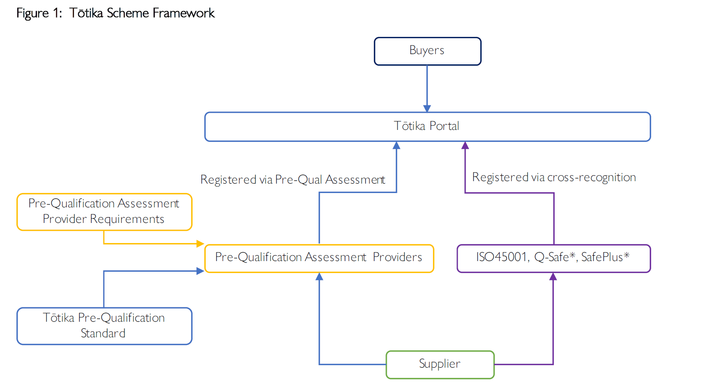
The final framework agreed to resulted in cross recognition pathways being developed that recognise standards and in turn certification

Slide 17
So…..what does this mean for certification? and what is Telarc doing to support Totika?
Certification is growing as a mechanism to provide confidence and comfort for Boards, Owners, Senior leaders, Customers, Regulators and Industry Bodies
Telarc has trained and approved 26 auditors to support the growing ISO45001 opportunity
Most of the large construction companies are ISO45001 certified
An increasing number of high risk companies are applying to be certified – e.g. scaffolders
We have worked with Worksafe and ACC to ensure Q-Safe meets their expectations
Provide a scheme and pricing model that does not dis-advantage the regions
Ensure workers voices are at the forefront of the audit process
Ensure impartiality is achieved at all times
Understand that overall H&S performance improvement is a journey not a sprint
Telarc is working with a select group of consultants to ensure the Q-Safe framework is understood and is being built into their consult approach
Telarc is establishing a regional support model through the engagement and on boarding of a select group of H&S professionals capable of providing impartial auditing services.

Slide 18
Getting involved in certification does require the right mind-set.
The structure now used to conduct audits against most standards requires assessment against the “Think, Plan, Do, Check, Act” framework.
Worker participation and worker understanding is becoming increasingly important to regulators
We like to see ourselves as value adders and we find our most difficult assignments are when we are seen as a “necessary evil”
It does take some investment from you – time, effort and capital
The auditor is not there to find everything wrong with your business….they do try to find things that are right as well……..so being well prepared is important
We are increasingly seeing our clients using certification as a way of differentiating their offer during the tender or sales process
If you need more detail please go to our website www.telarc.co.nz or ring us on 0800 004 004

